Slide 1
Global reach, local impact

Slide 2
A major metropolitan university

Slide 3
A bit of history!
From the end of the XIXth century to 1968: The faculties are merged into Aix-Marseille University, chaired by the Rector of the Academy
1970-1973: Aix-Marseille Universities I, II and III are created
2007-2009: The merger of the three universities is thought through and Aix-Marseille Université’s founding principles are adopted
December 10th, 2010: The university’s legal status are voted
November 28th and 29th, 2011: The three councils are elected
January 1st, 2012: Aix-Marseille University is created

Slide 4
Aix-Marseille Université in a nutshell 1/2
More than 80,000 students, including 10,000 international students
Over 3,000 doctoral students 39,5% of whom are from abroad (from 105 countries)
A staff of 8,000, including 4,400 senior lecturers
17 faculties, schools or institutes
18 Aix-Marseille Université institutes
1 institute for advanced studies of Aix-Marseille Université : IMéRA
122 research structures
including 113 research units and 9 federative research structures
12 doctoral schools
820,000 m² net floor area for 5 campuses
A budget of €720 Millions
1 City of Innovation and Knowledge (CISAM)
1 European Civic University (CIVIS) in cooperation with 9 universities
1 long-term Initiative of Excellence (IDEX) project (€26 Million per year)

Slide 5
Aix-Marseille Université in a nutshell 2/2
Owner of nearly 90% of the property assets it occupies
Grant of €61 Millions in the context of the national recovery plan for the renovation of its buildings
6 education and research fields
    Arts, humanities, languages and social sciences
    Law and political science
    Economics and management
    Health
    Science and technology
    Multidisciplinary sector (technological institute and education departement)
3 PIT (territorial innovation clusters)
5 interdisciplinary research interests
    Energy
    The environment
    Health and life sciences
    Advanced sciences and technologies
    The humanities

Slide 6
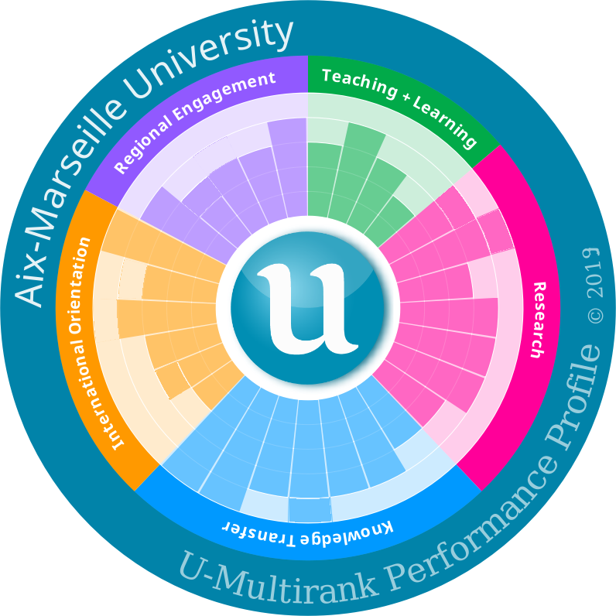



Aix-Marseille Université in World University Rankings
        138th in the 2021 Shanghai ranking
        1st Euro-Mediterranean university on the north bank
Best Grade in
Research Publications (absolute numbers & size normalised)
Publications cited in patents
Publications with an industrial partner
Income from continuous professional development
Patents awarded (absolute numbers)
International academic staff
            Top 100 in
Oceanography
Mathematics
Physics
Earth Science
Human Biological Sciences
Metallurgical engineering
100-150th in Research Rankings
(Leiden Impact & Collaboration, NTU, Essential Science Indicators)

Slide 7
Scientific Production : Evolution & Quality
7 050 documents dans le WoS
72 % Open Access
Copublications en 2020 :
57% World
34% Europe
15% in Top 10% Monde
1 211 Highly Cited Papers
(top world 1% last 10 years)
45 Hot Papers
  (top world 0,1% last 2 years)
update : 26/01/2022
57% of Web of Science (WoS) Documents in Q1
(best quartile of international journals : 3,650 journals)
Source : Web of Science & InCites

Slide 8
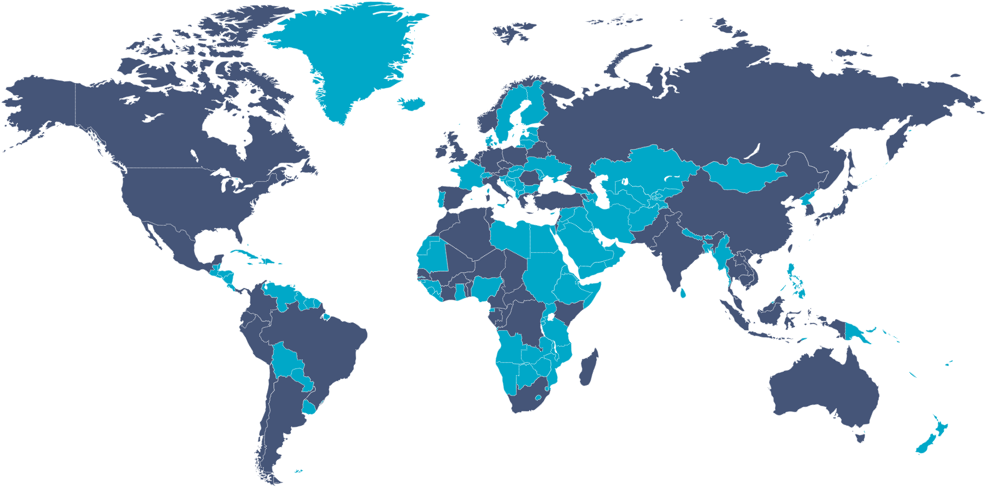
A metropolitan university
Aix-Marseille Université is located in the south of France,
3 hours away from Paris by high speed train.
less than 2 hours away from the main European and Mediterranean capitals
by plane.
Stockolm
London
Berlin
Varsaw
Paris
Rome
Madrid

Slide 9
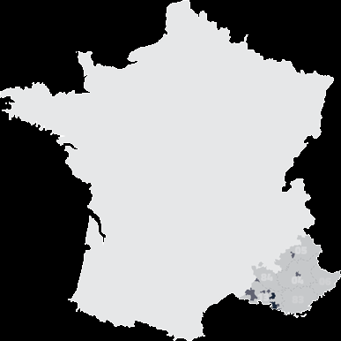
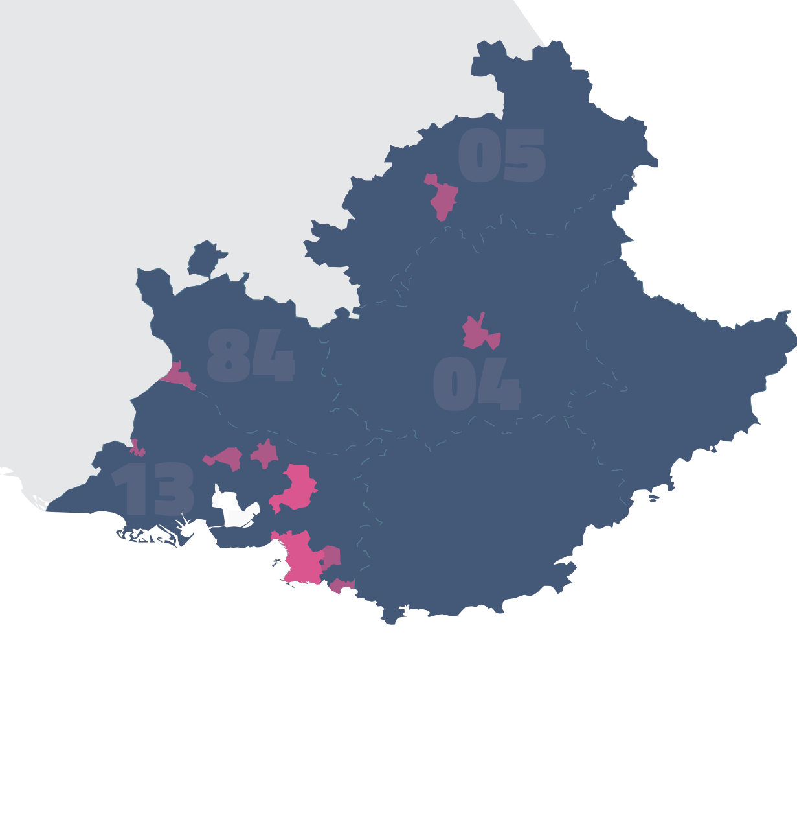
A metropolitan university
1 academy
9 cities
The Provence-Alpes Côte d’Azur Region
The third French region in terms of GDP
With more than 1.5 million people
Aix-Marseille is the 3rd largest urban area in France
Gap
Digne-les-Bains
Avignon
Arles
Salon-de-Provence
Lambesc
Aix-en-Provence
Marseille
Aubagne
La Ciotat

Slide 10
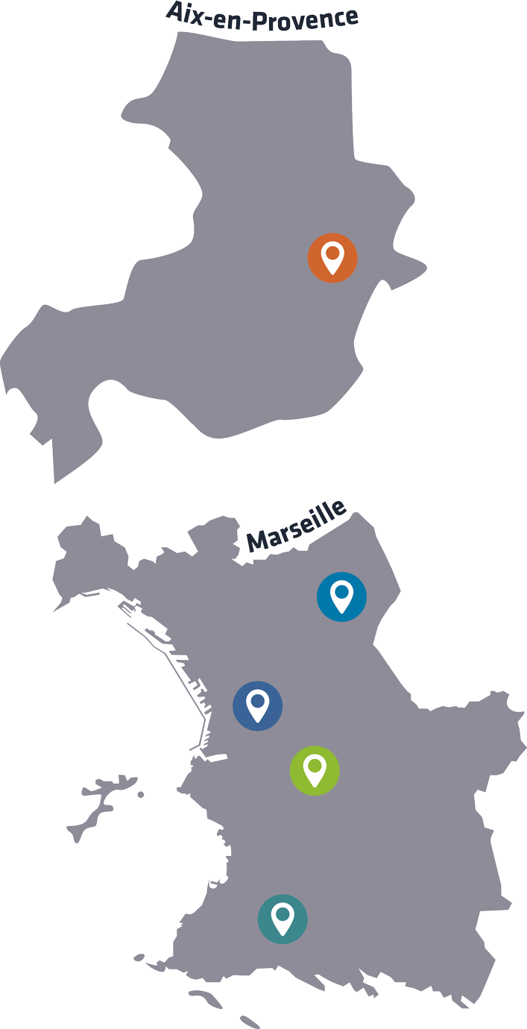
5 campuses
6 academic departments
820 000 m² net floor area
Arles
ALLSH
Campus
Aix-en-Provence
FDSP
FEG
OSU - Pythéas
Arts, letters, languages and human sciences Department
ALLSH
IMPGT
IUT
FEG
IRT
Avignon
ALLSH : Faculty of arts, humanities, languages and social sciences
CFMI : Training center for music facilitators
MMSH : Mediterranean social science center
FS
MMSH
FDSP
CFMI
ESPE
IUT
ESPE
Economics and management Department
IAE
Aubagne
FEG : Faculty of economics and management
IAE : Aix-Marseille graduate school of management
EJCAM : Aix-Marseille school of journalism and communication
IRT : Regional labor institute
FSS
FS (SATIS)
Law and politics Department
Digne-les-Bains
Campus
Marseille-Etoile
ESPE
FDSP : Faculty of law and political science
IMPGT : Institute of public management and territorial governance
IUT
FS
POLYTECH
Science and technology Department
IUT
OSU-Pythéas
Gap
Campus
Marseille-Centre
FEG
FS : Faculty of science
FSS : Faculty of sports science
OSU-Pythéas : Pythéas institute – earth sciences and astronomy observatory
POLYTECH : Polytech Marseille
FSS
ALLSH
FDSP
Campus
Marseille-Timone
IUT
FS
IMPGT
La Ciotat
Health Department
FEG
ESPE
MEDECINE
EU3M
EJCAM
IUT
MEDECINE : Faculty of medicine
PHARMA : Faculty of pharmacy
ODONTO : Faculty of dentistry
EU3M : Marseille Mediterranée university school of midwifery
PHARMA
ODONTO
Salon-de-Provence
Campus
Marseille-Luminy
Multidisciplinary Department
FS
POLYTECH
IUT
ESPE : School of teaching and education
IUT : Aix-Marseille university institute of technology
IUT
OSU-Pythéas
FSS

Slide 11
A research-intensive university

Slide 12







A close partnership between Aix-Marseille Université and major research institutions
122 research structures
including 113 research units
and 9 federative research
structures

Slide 13

Our research is interdisciplinary
5 Interdisciplinary and cross-sector
research poles (PR2I)
Priorities and world-class research
Nuclear fusion and fission
Bioenergy
Energy storage
Energy efficiency
Energy transition
Energy
Environment
Climatology
Man/Environment interactions
Resources
Oceanology
Cross-cutting Subjects
Imaging
Nanosciences
Sports and
well-being
Big Data
Mediterranean Space
Oncology
Immunology
Neurosciences
Microbiology and infectious diseases
Imaging
Genetics
Nutrition/Cardiovascular
Health and life science
Optics/Photonics
Microelectronics
Aeronautics/Spatial domain
Mathematics
Particle physics
Astronomy/Cosmology
Sciences and advanced
technologies
Mediterranean studies
Digital humanities
Migrations
Archeology
Brain/Languages
Globalization
Economics/Public policies
Law
Humanities

Slide 14



Our research is renowned
H2020 Results (2014-2020) :
117 projects for €71,55 Million
1st French university in the Health H2020 program
2nd French university in amount of obtained grants
255 projects on the entire site for €158,8 Million
40 ERC projects have been funded on the Aix-Marseille site (Results 2014-2020)
3 Starting Grant ERC projects for the 1st of Horizon Europe (2021)
European projects Council (ERC) Club
on the Aix-Marseille site

Slide 15
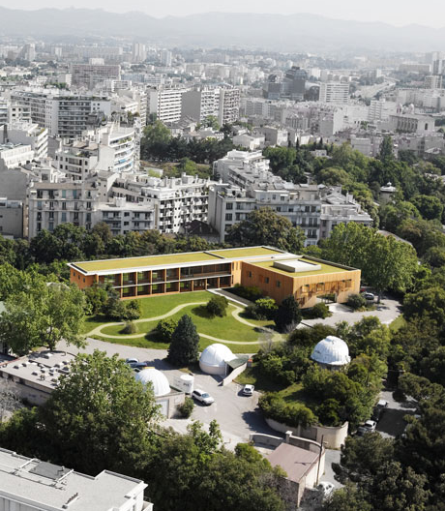

IMéRA: Institute for Advanced Studies of Aix-Marseille Université
Emergence and development of world-class interdisciplinary research
IMéRA has a residency program for researchers and artists (from 3 to 12 months) and plays host to multidisciplinary teams with collective projects for short-term stays
IMéRA is a member of the French Network of Institutes for Advanced Studies (Labex RFIEA+), the Eurias Network and the European Network of “University Based” institutes

Slide 16
Doctoral training
12 doctoral schools
3,400 doctoral students
including 39% of international ones
Doctoral College
700 degrees issued every year in 79 specialities
85 PhD programs
41disciplines
Around 800 doctoral students recruited
every year

Slide 17




Research and technology transfer
Department for research and technology transfer
Competitivity clusters and Major structuring programs (OIR)
Support to the regional strategy of innovation
  Awarding: arbitration and expert assessment
  Delegations
  Applied Research Fund (FUI)
  Patents and Licences
  Business creation
  Arbitration of research and technology transfer projects
  Startups hosting
  Contract management
  Litigation management
RESEARCH
AND
TECHNOLOGY
TRANSFER
COMMITTEE
Contract management in connection with companies
COMPANIES
Boost and Licensing
Startups creation

Slide 18








Une force pour le territoire
The CISAM,
«Cité de l’Innovation et des Savoirs Aix-Marseille»

Slide 19


La CISAM, a hub for innovation in Aix-Marseille
Public and private players come together to facilitate innovation in a unique place of entrepreneurial creativity.
An unprecedented gathering of innovation players :
Aix-Marseille Université the largest French-speaking university, has multiple strengths and international recognition to meet the challenge of innovation through its research structures and technological platforms.
Supported by Aix-Marseille Provence Métropolis, l’Accélérateur M supports local startups in the fields of the sea and the blue economy, creative and cultural industries and the quality of urban life in the Mediterranean area.
ZEBOX, the international accelerator incubator led by the CMA CGM Group. Specialist in 2 major sectorial domains : transport, logistics, mobilities, and industry 4.0 at the heart of cutting-edge technology projects (AI, IoT, VR...).
OBRATORI, , startup studio of L’OCCITANE Group, is oriented towards innovation projects in the fields of cosmetic, well-being and digital solutions for retail.

Slide 20
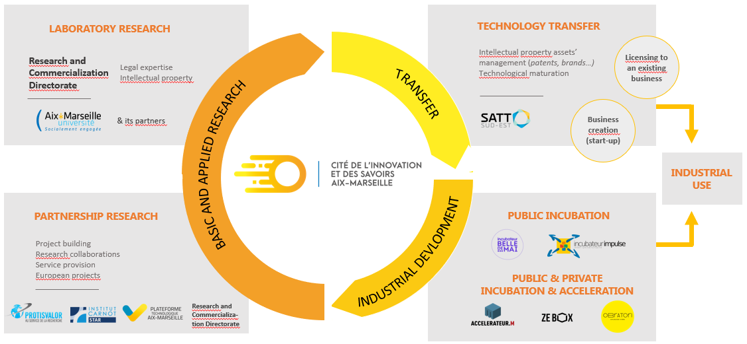
Public research valorisation process
→
CISAM hosts the global innovation journey and facilitates exchanges between the players of the ecosystem.

Slide 21









Services provided by the CISAM
→ Connect & support the innovation ecosystem in Aix-Marseille Metropolis
CONNECT TO :
TALENTS
RESEARCH
LABORATORIES
DEVELOPMENT
STAKEHOLDERS
Incubators, accelerators
Competitiveness clusters
Industrial players
Financing stakeholders
Valorisation and Transfer Technology Offices
etc…
Recruitment : students, post-doc, engineers …
PhD (CIFRE industrial research agreements)
Challenges students
Qualified contact with laboratories and technological platforms
Searching for patents from laboratories
Continuing education
Submissions to calls for projects (Amidex, Horizon Europe…)
SUPPORT :
COACHING, EXPERTISE AND MENTORING
ASSISTANCE IN SEARCHING FOR FINANCING
CO-INNOVATION
HOSTING
MORE INFORMATIONS :
www.cisam-innovation.com

Slide 22
Une force pour le territoire
CISAM, a place for innovation
Born out of the skills and ambitions of the 4 founding members: Aix-Marseille Université, the Aix-Marseille Provence Metropolis, the CMA-CGM Group (ZeBox) and the L'Occitane Group (Obratory), CISAM is an innovative place open to all, in term of wealth creation and incubation for projects.
Bringing together actors in innovation for the first time
  Aix-Marseille Université, with its international recognition has all the assets to meet the challenge of innovation. All these services and partners focused on accelerating the societal transformation of public research innovations.
  The accelerator M, driven by the Aix-Marseille-Provence Metropolis proposes services conducive to the development of projects carried by foreign partners in the fields of the sea, creative industries, urban modernisation and open innovation.
  ZEBOX, the international accelerator incubator driven by CMA CGM Group with two sectoral areas: transport, logistics, mobility, and industry X.0. with advanced technologies such as Artificial Intelligence at the heart of each selected project.
  OBRATORI, L’OCCITANE Group’s startup studio. Focused on innovations in the field of cosmetics, wellbeing and digital solutions for retail.

Slide 23
A wide range of learning opportunities and a dynamic student life

Slide 24

















A wide, multidisciplinary and interdisciplinary range of learning opportunities – 17 faculties
Health
Science and technology
Economics and management
5 Academic Departments
Law and politics
Arts, letters, languages and human sciences
Multidisciplinary sector

Slide 25
A wide, multidisciplinary and interdisciplinary range of learning opportunities
Bachelor’s degree
37 mentions
Techological University Bachelor
18 diplomas
108 vocational degree programs
Professional bachelor’s degree
58 mentions
78 vocational degree programs
Master’s degree
99 mention
327 vocational programs
35 vocational degree vocational programs
Engineering diplomas
8 diplomas
Institutional diplomas
407 diplomas
Doctorate
10 disciplinary fields
State diplomas
5 state health diplomas
5 state paramedical diplomas
85 PhD programs
41 disciplines

Slide 26
Lifelong training
1 dedicated service: Lifelongtraing Service (DATADOCK referencing in 2017)
Double ISO 9001 certification, Qualiopi RNQ 1st university to have obtained it by 30 July 2020, and referenced on the DATADOCK since 2017.
Specific personalised support systems: construction of one's professional project, recommendation of training course adjustments, support for professional retraining, contribution to the management of jobs and professional careers, training engineering combining financial engineering.
Tailor-made training for companies and individuals, experimental work on themes such as Caregivers' Trajectories.
Post-training support workshops (resume, cover letter, softskills, life skills, time and priority management, ...).
Short training courses based on the expertise of the components and research units.
Preparation for category A and B administrative competitions.
Validation of prior learning and experience
Skills assessment centre
Diploma of Access to University Studies

Slide 27
Pedagogical training
CIPE: Centre for pedagogical innovation and evaluation
Pedagogical training programs
117 training sessions in 2016 (800 training hours),
2 diploma training courses, conferences…
Support to digital projects for education and tools development : AMUpod…
Support to exchange and initiatives
CaféTICE, Workshops on pedagogic changes…
For students
PracTICE trainings for bachelor students in TICE (Information and Communication Technologies in Education)

Slide 28



A dynamic student life, supported by the university
160 student associations
Federative events: Forum of associations,
Festiv’AMU, the prom, OSAMU (symphony orchestra), the JazzBand…
Support to student initiatives (FSDIE) :
    Projects (€567,000 in 2019 – €360,000 in 2020 covid crisis impact)
    Social (€80,100 in 2019 – €496,500 in 2020 covid crisis impact)
Culture card
Special status for high-level athletes and artists
Access-to-healthcare network for students
Services and support to physically-challenged students
Network of academic libraries (BU)

Slide 29
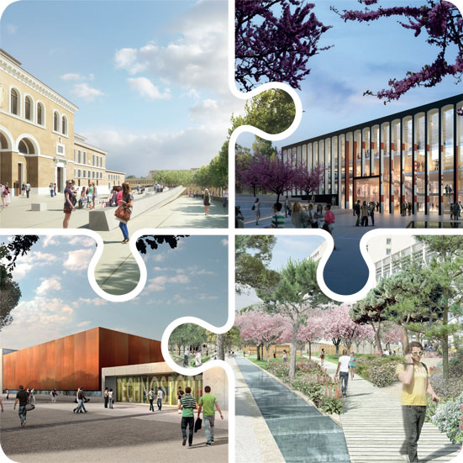

Fully refurbished campuses, in line with international standards
Campus Operation (2011-2020):
A €500 Million state-funded grant
2 main sites:
- Aix-Quartier des facultés campus
- Marseille-Luminy campus
State-Region Planning Contracts (2015-2020)
For other sites of Aix-Marseille Université
AMU endowed with €61.1 million in 2020 for the energy renovation of its buildings as part of the National Recovery Plan
Devolution of formely state-owned property:
Aix-Marseille Université owner of nearly 90% of its property assets it occupies

Slide 30
Aix-Marseille Université institutes a transversal approach based on the research units and faculties

Slide 31
Aix-Marseille Université institutes
Created mid 2019, the result of a transdisciplinary approach based on the research units and faculties of the university
At the cutting edge of innovation, these institutes for research and education promote Aix-Marseille Université as a centre of excellence, with the aim of increasing the visibility of the institution at the national and international levels.
Their uniqueness is to combine high-level education and intensive research within Graduate school, delivering an excellent training.
Their main challenges:
    to generate new knowledge and know-how through the prism of interdisciplinarity
    to bring out talent, to attract the best researchers
    to obtain external funding

Slide 32
Aix-Marseille Université institutes
Research
Education
To be a place for the emergence of new inter-team, disciplinary or interdisciplinary collaborations
To conduct a prospective approach, i.e. to carry a vision for the future on a given scientific research theme and to support its implementation
Establish a strong link between education and research link to train new generations of scientists based on the graduate school model
To promote a far-reaching and farsighted international policy
Attractiveness / International
Innovation & cultural and socio-economic impact
To develop and attract talented people (national and international students, research engineers, research teaching fellows)
To draw attention to the institute’s core thematic areas and be better placed for international outreach, together with a consolidation of long term relationships with a number of academic partners
Strengthen collaborations with socio-economic and cultural key players
Develop vocational training practice
Collaborate with innovation stakeholders
Enhance the value of Aix-Marseille Université technological platforms

Slide 33
Aix-Marseille Université institutes
18 institutes
Institute for Cancer and Immunology
Institute Marseille Imaging
Institute for Mediterranean Archaeology
Institute NeuroMarseille
Aix-Marseille Institute for Creativity and Innovations
Institute Marseille Rare diseases
Institute for Microbiology, Bioenergy and Biotechnology
Institute for Physics of the Universe
Institute Archimedes Mathematics and Computer Science
Institute for Mechanical Science and Engineering
Institute of Mediterranean Societies in Transition
Mediterranean Institute for the Environmental Transition
Institute for Fusion and Instrumentation Sciences in Nuclear Environments
Institute for Advanced Materials and Nanotechnologies
Aix-Marseille Institute for Public Health Sciences
Institute for Ocean Sciences
Institute Laënnec - Digital sciences and AI for health
Institute Origines – From the formation of planets to the emergence of life
Interdiciplinary research interests
Energy
Environment
Health and life sciences
Advanced sciences and technologies
Humanities

Slide 34
One of the few IDEX (Initiative of Excellence) awarded universities

Slide 35





One of the 3 IDEX awarded French universities (since 2016)
A funding in capital
of €750 Million
or €26 Million/year
Promoting AMU and its region abroad
AMIDEX
Developing innovative and interdisciplinary teaching methods
Supporting collaborative and interdisciplinary research, as well as innovation
Strenghening AMU’s partnerships with the socio-economic world
Strenghening AMU’s attractivity and reputation abroad

Slide 36
One of the 3 IDEX awarded French universities (since 2016)
5 strategic priorities
A leverage tool for Aix-Marseille Université
to fund cutting-edge
academic projects
Energy
Health and life sciences
Sciences and advanced technologies
Environment
Humanities

Slide 37
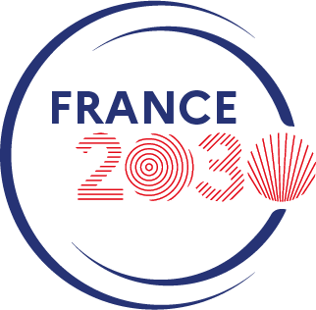
Other projects funded by the
Investissements d’Avenir Program
PIA 2 :
22 Laboratories of Excellence (LABEX),
11 Equipments of Excellence (EQUIPEX),
5 Carnot institutes,
2 Convergence institutes,
2 RHU,
1 Development structure (SATT),
1 Hospital-University Institute (IHU)
PIA 3 : 5 major projects for student success, including:
DREAM-U « Dessine ton PaRcours vers la REussite à AixMarseille Université »
Funding of 10 400 000€ for 10 years
PANORAMA « Pour l’AccompagNement à l’Orientation et à la Réussite à Aix-Marseille Avignon et Toulon »
Funding of 7 500 000 € for years
TIGER « Transform and Innovate in Graduate Education with Research » Funding of 23 000 000 € pour 9 years
IDeAL « Integration and Development at Aix-Marseille through Learning » Funding of 19 000 000 € for 9 years
AMPIRIC « Aix-Marseille – Pôle d’Innovation, de Recherche, d’Enseignement pour l’Éducation »
Funding of 9 900 000 € for 10 years
yzai
+ d’infos http://url.univ-amu.fr/lettreamu_projets-structurants
PIA 4 : 1 major project to participate
in the creation of value in the metropolitan area
CISAM+
Funding of 40 000 000€ for 10 years
jjdp
+ d’infos http://url.univ-amu.fr/lettre-amu_cisamplus

Slide 38
The Aix-Marseille Université foundation
IDEX grant funding
Donor partners

Slide 39
A world-class university, with strong local roots in the Euro-Mediterranean area

Slide 40
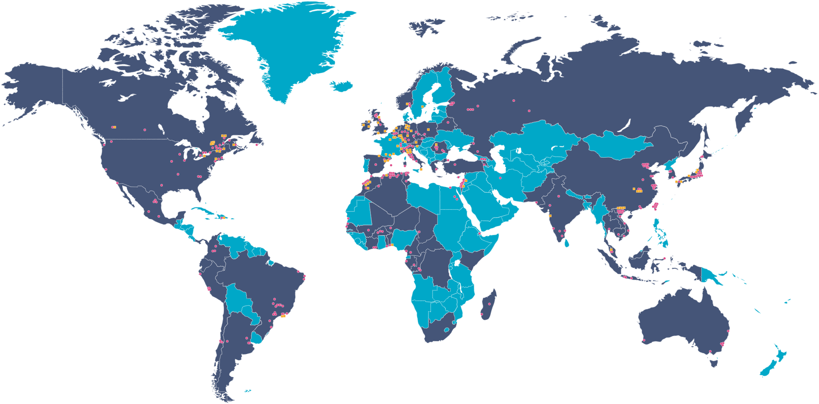
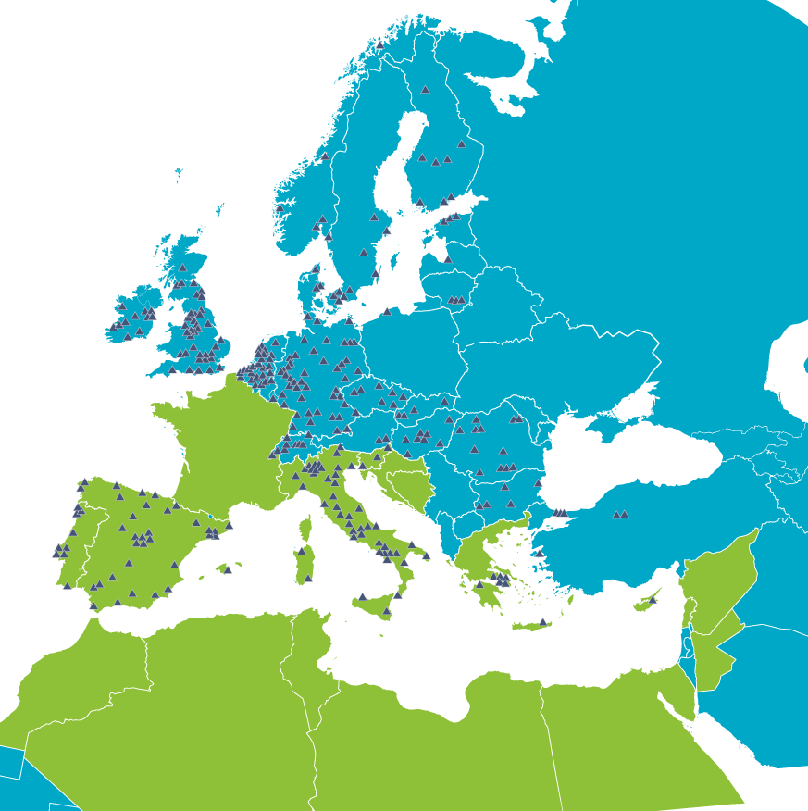
350 international cooperation agreements
367 Erasmus+ partnerships
Near 30 Erasmus+ and Erasmus mundus projects
More than 1,100 outgoing students, in 590 partner institutions in 62 countries
More than 40 international diplomas in international cooperation
22 international laboratories
1 French-Chinese institute «WUT-AMU» in Wuhan (China)
Creation of 1 European Civic University (CIVIS)
1 permanent represantation of Aix-Marseille Université in Brussels (Belgium)
Partner University
Partner University for a diploma
Country with a cooperation agreement
Country without a cooperation agreement
ERASMUS partner
Téthys Consortium country

Slide 41
Main partners in regard to international policy
Spain
Italy
Germany
China
Canada
Japan
USA
Vietnam
Mexico
Lebanon
Brazil
Tunisia
Senegal
Algeria
Mali
Morocco

Slide 42
A world-class university involved in in its European space

Slide 43
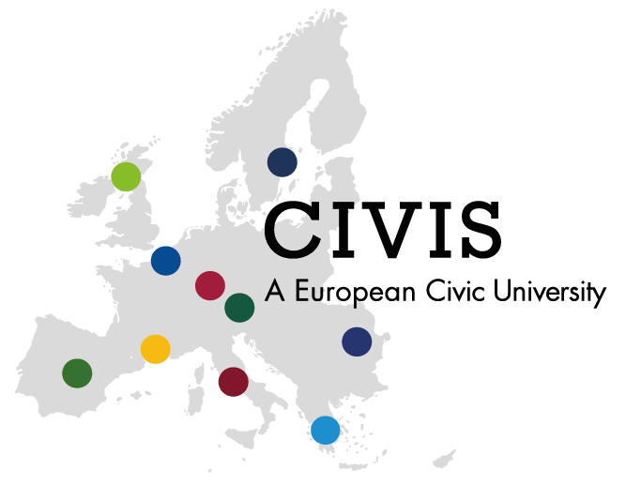
CIVIS – Creation of a European Civic University
Emerging from the Bologna process initiated in 1998, the "CIVIS" alliance, led by Aix-Marseille Université alongside 7 European universities, is the winner of the European Commission's call for projects on European universities in June 2019.
As an essential instrument for the renewal of the European integration process, the alliance must promote the physical and virtual mobility of staff and students and build bridges between the academic, socio-economic and cultural worlds.
Aix-Marseille Université is a leader alongside 8 universities:
    Kapodistrian University of Athens (Greece),
    Bucarest University (Roumania),
    « Université Libre de Bruxelles » (Belgium),
    European University of Madrid (Spain),
    Roma la Sapienza university (Italy),
    Stockholm University (Sweden),
    Eberhard Karls Universität Tübingen (Germany)
    University of Glasgow (Scotland)
    Paris Lodron University of Salzburg - PLUS (Austria)
CIVIS will federate more than 470,000 students and 68,000 staff. This integrated university space aims to allow students, academics, researchers and staff to move and collaborate as freely as in their home institution.

Slide 44
CIVIS – Creation of a European Civic University
A space for innovative and responsible education, research, cultural exchanges and civic action in Europe, from the Baltic Sea to the Mediterranean Sea and Africa: Europe's bridge to the South over the Mediterranean area and Africa.
With its strong partnership dimension, CIVIS aims to become an important European player in 5 priority areas:
    health
    cities, territories and mobility
    climate, environment and energy
    digital and technological transformations
    society, cultures and heritage.
Themes address important societal issues and challenges, such as
sustainable development objectives as defined by the United Nations.
A decisive contribution to the attractiveness of the
alliance's universities on the world stage.
CIVIS - A European Civic University website
https://civis.eu/en

Slide 45
A university involved in its region, and participating to its prestige and attractiveness

Slide 46
A responsible university committed to CSR
  A vice-presidency dedicated to sustainable development: the fight against global warming and commitment to sustainable development are major issues of the university policy: adoption of a real estate energy plan, building renovation plan, travel plan, green plan, public education and information actions, ect.
  A vice-presidency dedicated to gender equality and the fight against discrimination: Aix-Marseille Université is a signatory to the charter "gender equality at work" carried by the NGO Business Professional Women. It also developed its own gender equality charter as well as a charter of commitment to LGBTI struggles. A system to combat sexual harassment, sexist, sexual and homophobic violence has been put in place for the whole community.
  A vice-presidency dedicated to health and integration of disabilities people
  A vice-presidency dedicated to campus life, quality of life at work and safety at work: a natural extension of global "human" development, for the benefit of students and staff on all university’s sites.
  Ranked 1st French university and 20th in the world by THE IMPACT in 2020: for its CSR policy

Slide 47
Many partnerships with socio-economic actors
  More than30 framework agreements have been signed with important industrial groups: : Airbus Helicopters, Crédit agricole, EDF, Société des eaux de Marseille, Safran, SNCF Logistics…
  A commitment with the competitive clusters
A strategic exploration committee
  Actions to foster the students’ vocational integration:
  The professional integration platform IPRO (for internships and recruitment)
  The PEPITE PACA OUEST hub for student entrepreneurship
  An annual event dedicated to it: “AHU / Companies encounters” (lasting one week)

Slide 48
A university involved in its region
A close cooperation with local authorities:
With the Region (regional scheme for higher education, research and innovation), with the Aix-Marseille-Provence Metropolis (member of the economic governance committee), with the Bouches-du-Rhône department (with an upcoming cooperation agreement)…
  Partnerships with the main local cultural actors:
  DRAC, La Criée National Theatre, Vasarely Foundation, Aix-en-Provence festival, MuCEM…
  Partnerships with the region’s major projects:
  Marseille-Provence Capital of culture 2013, Marseille-Provence Capital of sport 2017, Marseille-Provence association 2018
Aix-Marseille Université, a key actor in the dissemination of scientific culture:
Workshops in schools, conferences, “Souk des Sciences”, European night of research…

Slide 49
Leader of the common site policy

Slide 50


Aix-Marseille Université: leader of the Aix-Marseille Provence Méditerranée association
A site contract and conventions linking Aix-Marseille Université to its regional partners

Slide 51




The 4 Core Values of Aix-Marseille Université

Slide 52
An attractive environment
Come and see!

Slide 53
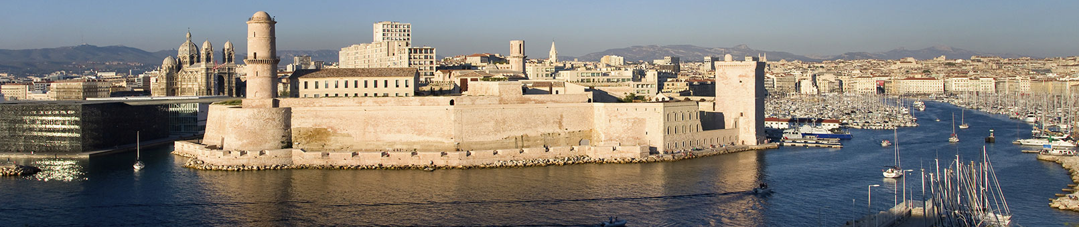
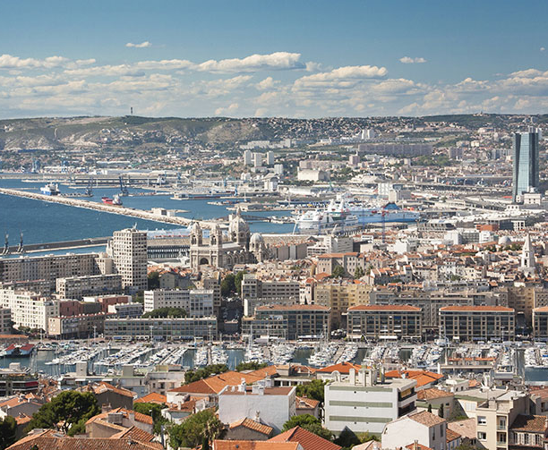
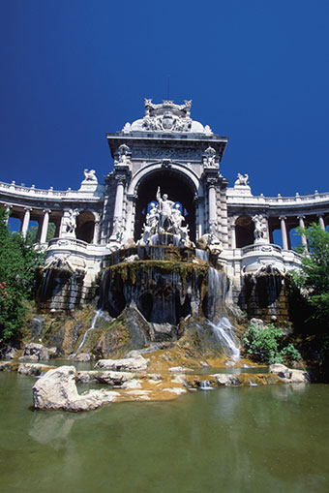
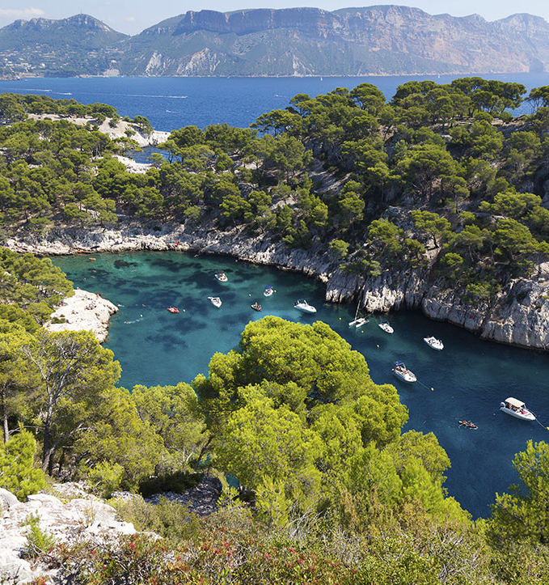
Marseille
A major sea harbor near the French Riviera, at the foot of the Parc national des Calanques

Slide 54
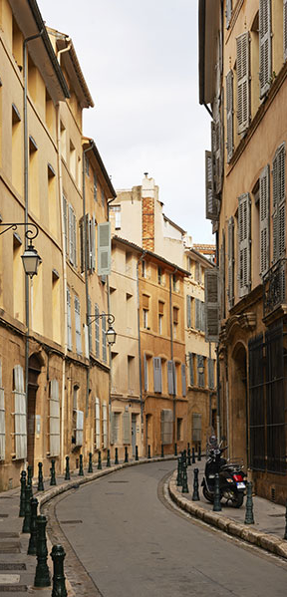
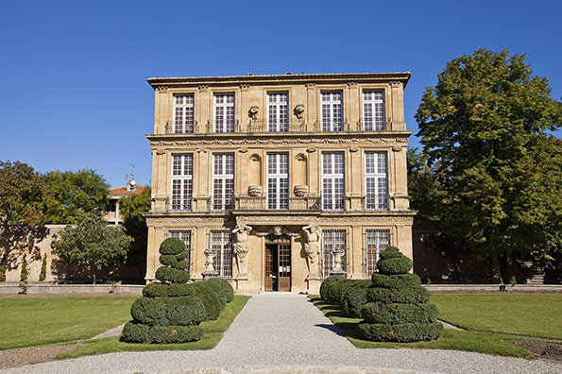
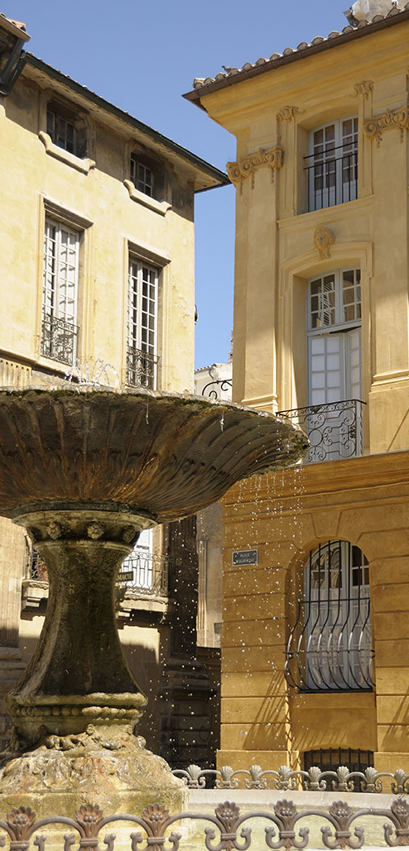
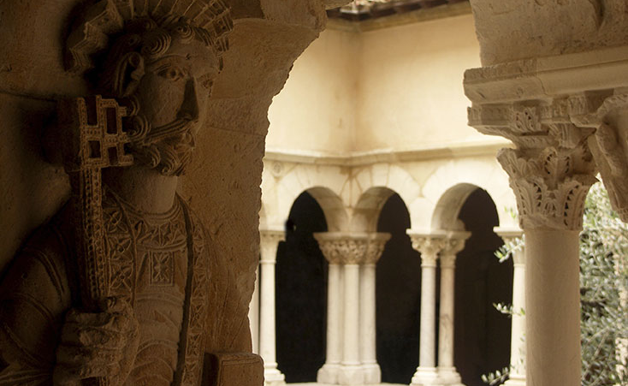
Aix-en-Provence
A vibrant historical city and arts center

Slide 55

www.univ-amu.fr/en

